Slide 1
Analysis of COVID-19:
Delta Variant
Bibek Dhungel
Anirudh
Dixa
Harshith
Paderborn | 12.08.2021

Slide 2
Contents
Overview
Task 1
Dataset and Preprocessing
Delta Variant Worldwide
Delta Variant UK, India and Russia
Delta cases VS Total cases
Task 2
Task 3
Task 4
Conclusion

Slide 3
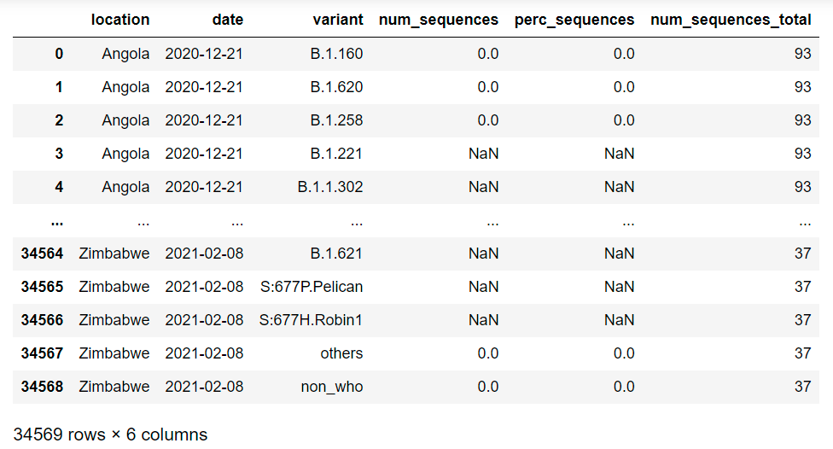
Task 1
Dataset and Preprocessing
The Dataset contains bi weekly data of COVID 19 cases
Data is available according to countries and the variants of COVID 19
The fields in the dataset shown represents:
Date: Bi weekly till 7th August 2021
Variant: Cases from each variant
num_sequence: No of positive cases
perc_sequence: Percentage of each variant to total cases
num_sequence_total: Total positive cases
Actual number are the cases that has been specifically tested for Variants.

Slide 4
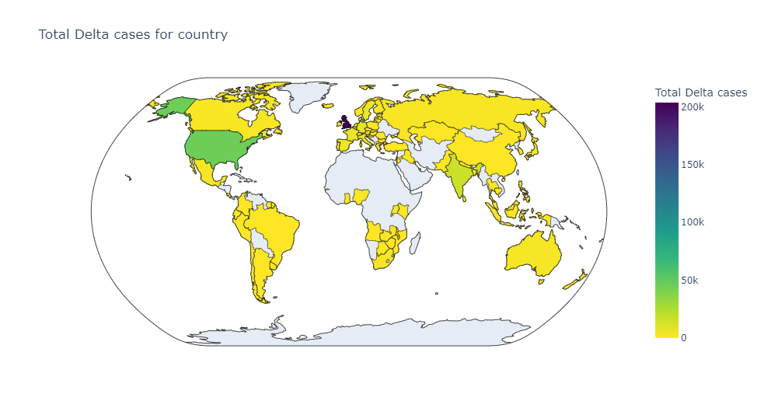
Delta Variant Worldwide

Slide 5
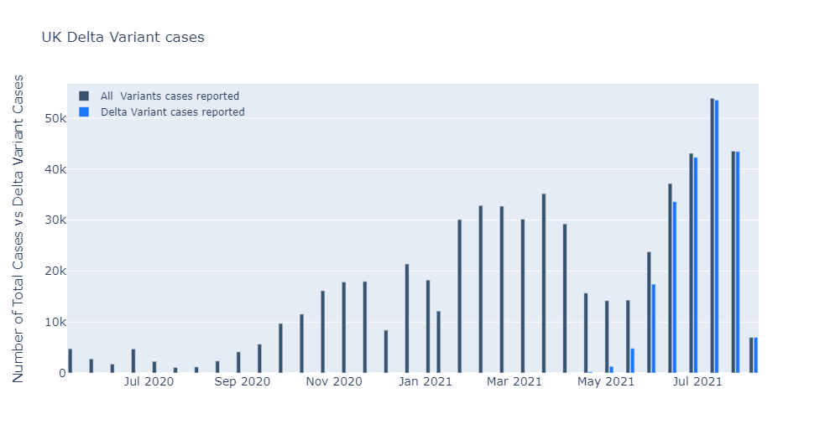
Delta Variant UK

Slide 6
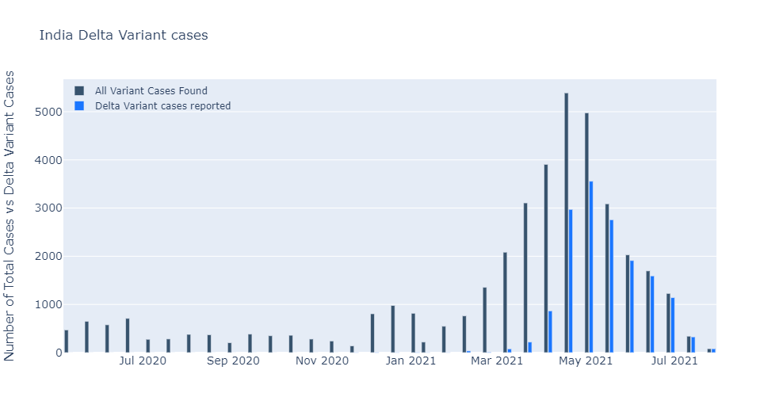
Delta Variant India

Slide 7
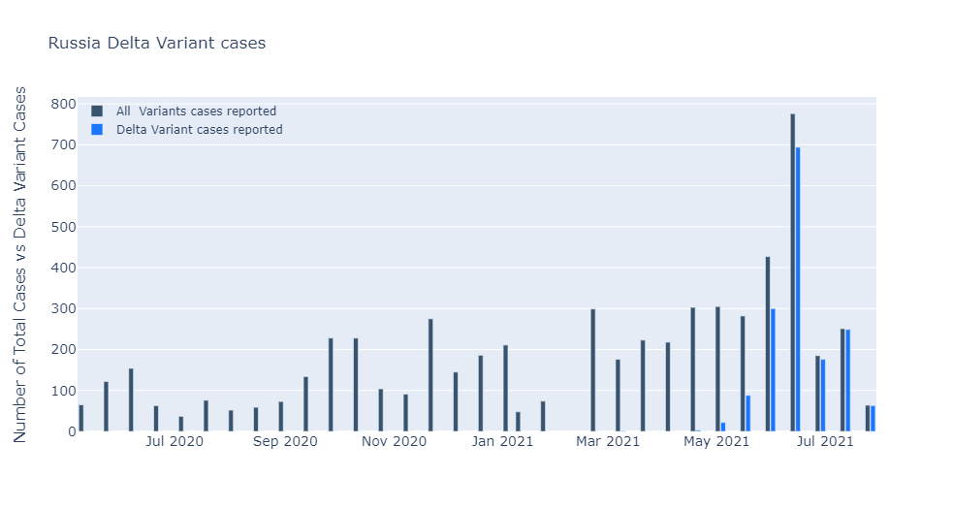
Delta Variant Russia

Slide 8
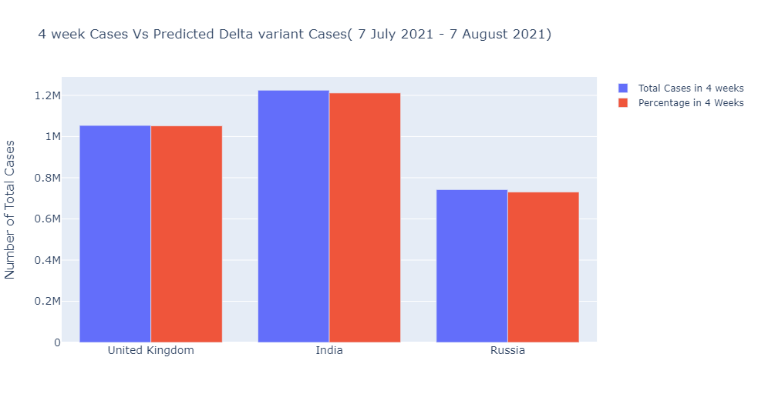
4 Week Total Cases VS Delta Variant

Slide 9
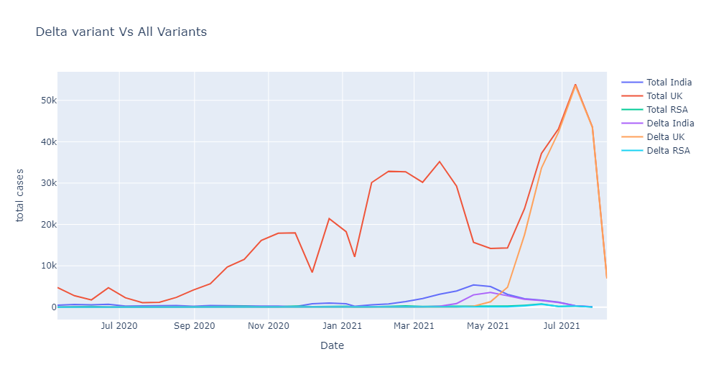
Total Cases VS Delta Variant

Slide 10
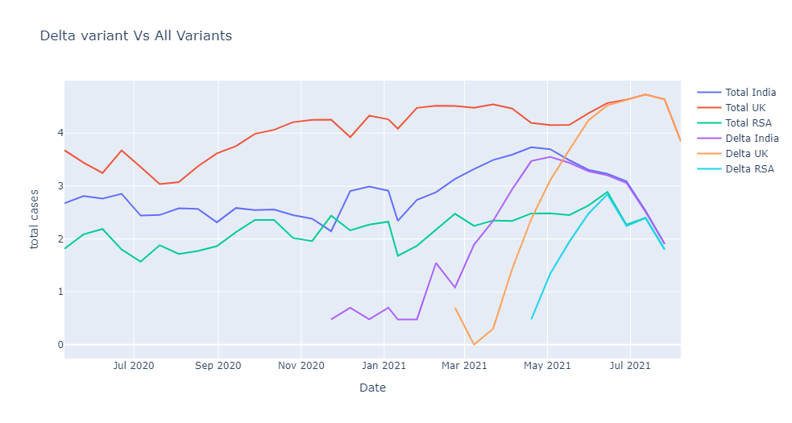
Total Cases VS Delta Variant (Logarithmic)

Slide 11
Task 2
Datasets used are from slide 3
Different factor has helped delta variant to spread. Cultural, religious, summer vacations, lockdown measures all have directly affected the delta variant situation in each countries.
The countries that have none to few restrictions has seen an exponential rise in the cases whereas the countries with somewhat decent or strict lockdown has few.
We will explore some of the causes of rise in delta variant in following slides.

Slide 12
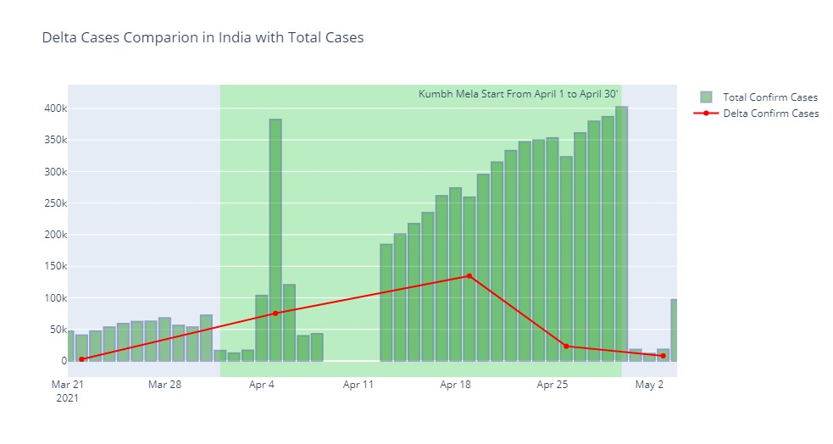
India: Cultural Event vs Positive Cases

Slide 13
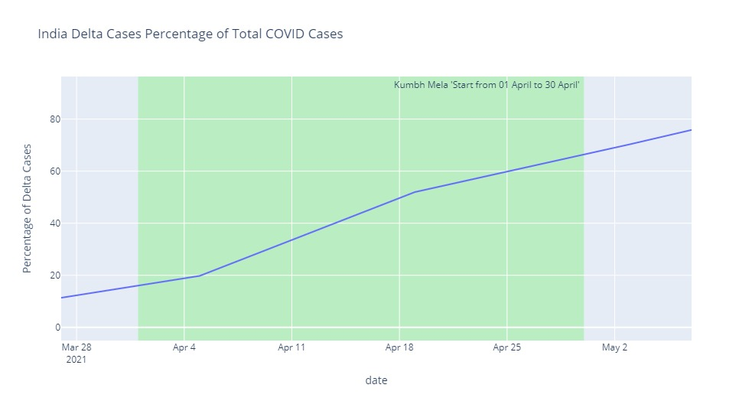
India: Rise of Delta during the period of mass gathering

Slide 14
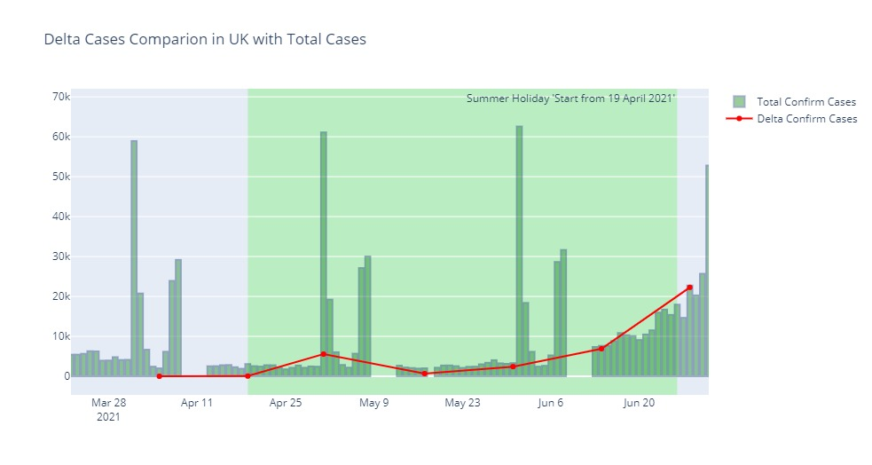
UK: Rise of Cases in Summer holiday

Slide 15
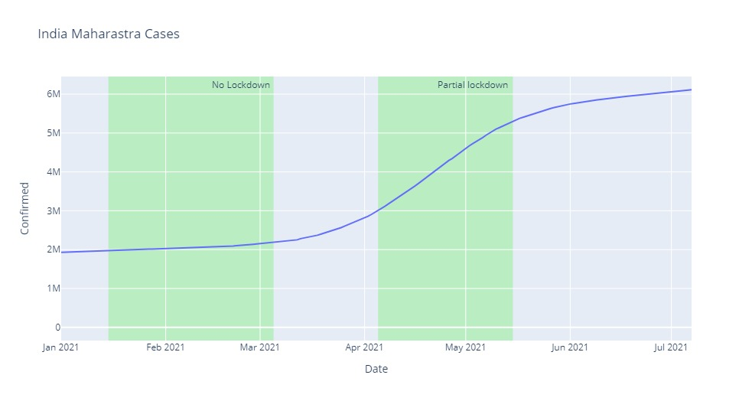
India (Maharastra): Lockdown effects to positive cases

Slide 16
Thank You..
Questions?

